Slide 1
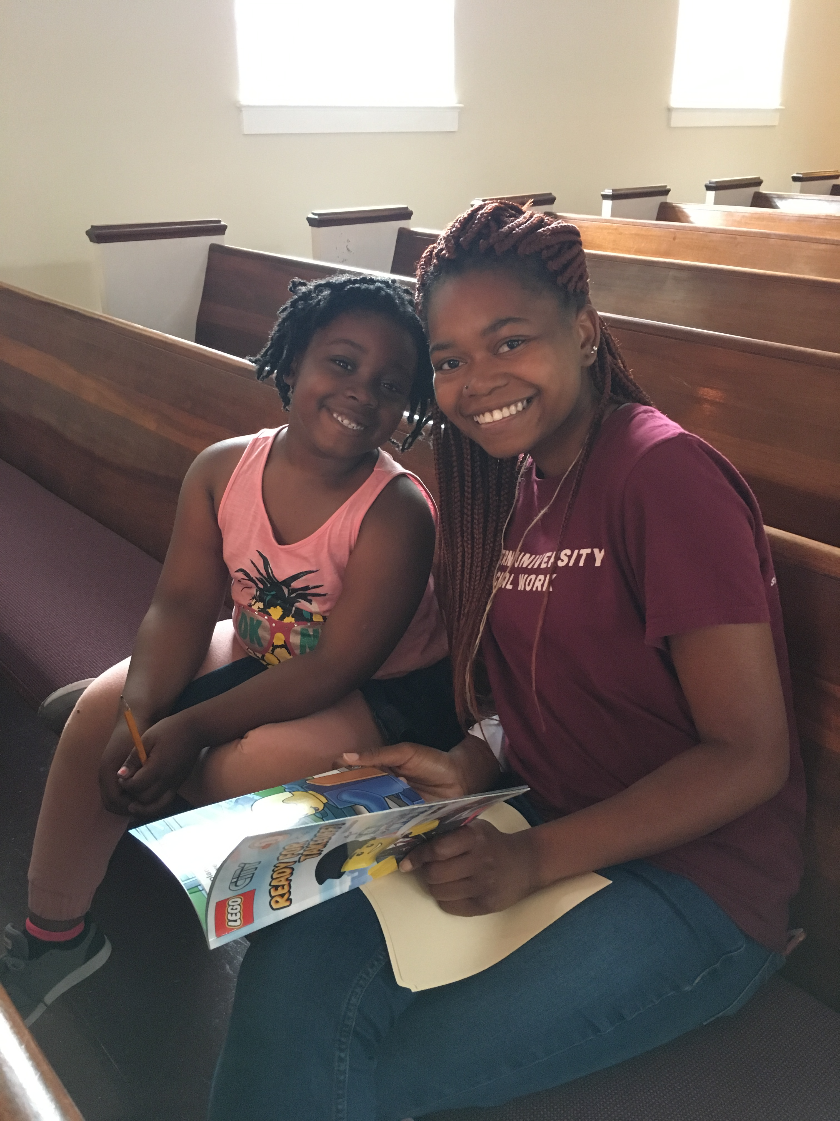
READ WITH PROJECT
TRANSFORMATION DC
Read with us on:
Dates
9:30-12:00
Host Church Name
Instructions to sign up

